Slide 1
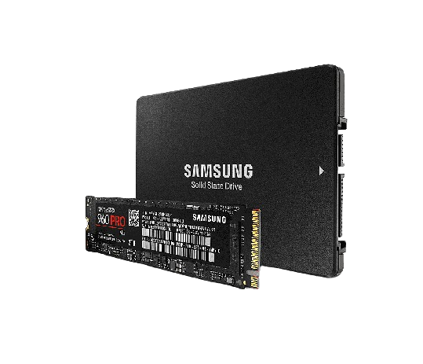
SSD drives: A Revolution in the world of storage

Slide 2
"
Welcome everyone ! Today, let's dive into the revolutionary world of SSDs, the storage gems that have transformed the way we approach data. From innovative technologies to their practical benefits, let's explore why SSDs have become essential in computing.
"

Slide 3
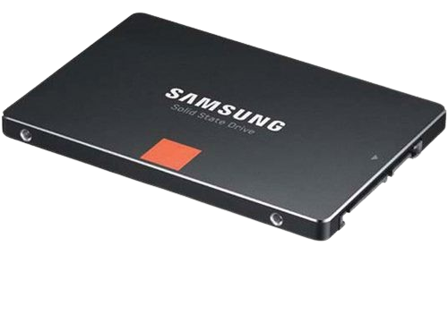
What is an SSD?
The SSD, or Solid State Drive, reinvents storage using NAND flash memory with no moving parts. This ensures data retention even when there is no power. By outperforming traditional hard drives, SSD offers a faster, more reliable, and more durable storage solution.

Slide 4
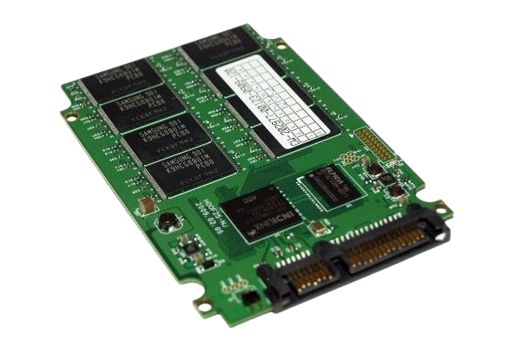
How SSDs work
Let’s take a closer look at how SSDs work. When you save or retrieve data, the SSD uses electrical charges to change the state of the memory cells. This process allows for much faster access times compared to hard drives, where read/write heads must physically move across rotating disks.

Slide 5

Advantages of SSDs
Solid State Drives (SSDs) offer several advantages over traditional hard disk drives (HDDs). Here are some of the main advantages of SSDs:
High Read and Write Speed: SSDs offer much faster read and write speeds compared to HDDs. This results in faster OS startup, faster application loading, and more responsive overall performance.
Minimized Access Time: Due to the absence of moving parts, SSDs eliminate the seek time required in traditional hard drives. Data can be accessed almost instantly, reducing overall access time.
Durability and Reliability: Since there are no moving parts in SSDs, they are more resistant to shock, vibration and physical impact compared to HDDs. This makes them more reliable, especially in mobile environments.

Slide 6
Advantages of SSDs
Energy Saving: SSDs generally consume less energy than hard drives. This power efficiency can contribute to extended battery life for laptops and reduced overall power consumption in systems.
Quiet: Since there are no moving mechanical components, SSDs operate quietly. This is in contrast to hard drives, which can produce noise due to spinning platters and moving read/write heads

Slide 7
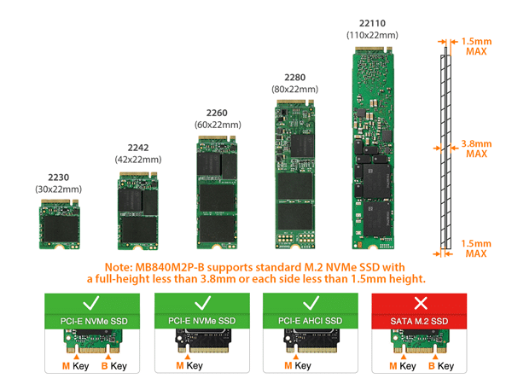
Types of SSDs
There are several types of SSDs, each with their own features and benefits. Here are the main types of SSD

Slide 8
Types of SSDs
It is important to choose the type of SSD based on the specific needs of the user or application, taking into account performance, capacity, compatibility and cost.

Slide 9
Installing a Solid State Drive (SSD)
Installing a Solid State Drive (SSD) is a great way to boost the performance of your computer, especially if you're upgrading from a traditional Hard Disk Drive (HDD). Here's a general guide on how to install an SSD:
Before you begin
Backup your data: Before making any hardware changes, it's crucial to back up your important data. This ensures that if anything goes wrong during the installation process, your data is safe.
Gather necessary tools: You'll likely need a screwdriver (typically Phillips-head), and depending on your computer, you might need additional tools to open the case.

Slide 10
Installing a Solid State Drive (SSD)
Shutdown your computer: Make sure your computer is completely powered off before you start.
Locate the hard drive bay: Identify where your existing hard drive is located. This is usually in the main drive bay, and it might be labeled or indicated in your computer's manual.
Open the case: Use the appropriate tools to open your computer case. This step varies depending on the type of computer you have. Laptops often have specific panels you can remove, while desktops may have side panels that you need to unscrew.
Locate the existing hard drive: Find the existing hard drive and identify the cables connected to it. Note which SATA port and power cable it's using.
Disconnect the cables: Gently disconnect the SATA and power cables from the existing hard drive. Be careful not to force anything, as connectors are usually delicate.
Remove the existing hard drive: If the drive is in a drive bay or bracket, unscrew it and carefully remove it from the computer.

Slide 11
Installing a Solid State Drive (SSD)
Install the SSD: If your SSD is the same form factor as your existing drive (e.g., 2.5-inch SATA), you can often install it in the same location. Secure the SSD in place using screws or any brackets that were used for the previous drive.
Connect cables to the SSD: Attach the SATA and power cables to the SSD. Ensure a secure connection, and make sure the cables are not putting stress on the SSD or interfering with other components.
Close the computer case: Securely close the computer case, making sure all screws are tightened.
Boot up your computer: Power on your computer and check if it recognizes the new SSD. If your SSD is not automatically detected, you may need to go into your computer's BIOS/UEFI settings and manually select the new drive or make sure the SATA port is enabled.
Format and install the operating system (if necessary): If you are using the SSD as your primary drive for the operating system, you might need to install the operating system. This usually involves booting from an installation media (such as a USB drive) and following the installation prompts.
Restore your data: Once the SSD is installed and the operating system is set up, you can restore your data from the backup.

Slide 12
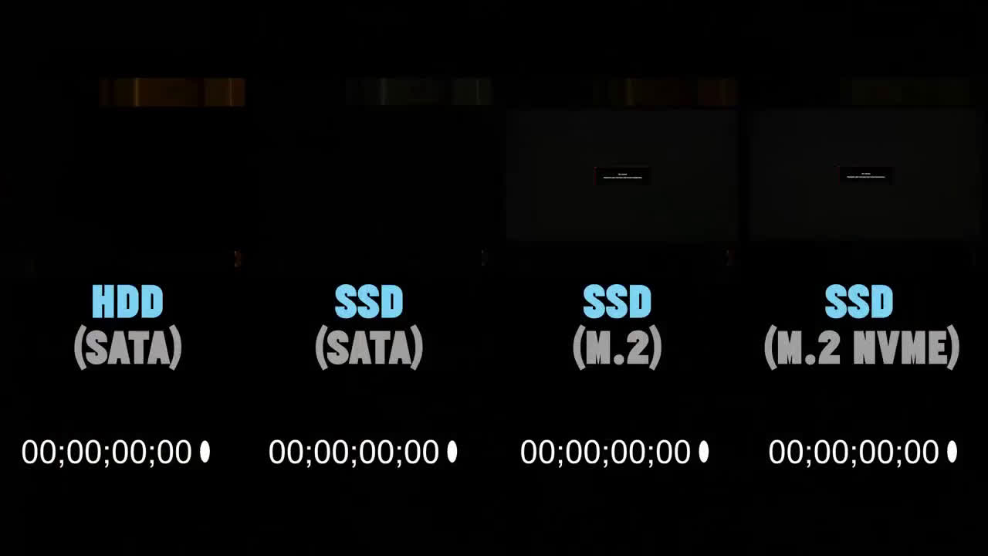
SSD vs HDD – Making the Right Choice
Time comparison

Slide 13

SSD vs HDD – Making the Right Choice
Play games

Slide 14
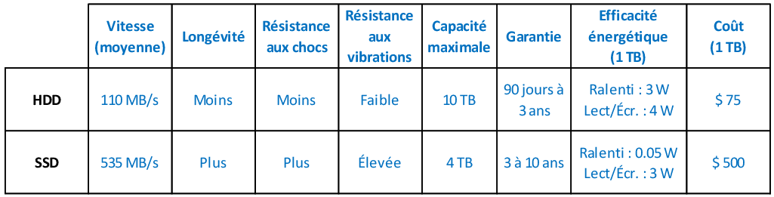
SSD vs HDD – Making the Right Choice

Slide 15
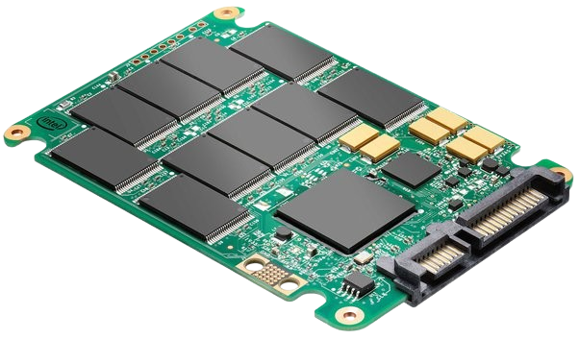
Maintenance and Lifespan of an SSD
The maintenance and lifespan of an SSD (Solid State Drive) can be optimized by following a few best practices. Here are tips to ensure the longevity and performance of your SSD:
Firmware Updates:
Make sure to check for firmware updates for your SSD regularly. Manufacturers sometimes release updates that improve SSD performance, compatibility, and stability.
Trim and Garbage Collection:
Enable the TRIM function in your operating system. TRIM allows the operating system to notify the SSD of data blocks that are no longer in use, thereby facilitating internal management of the SSD and preserving its performance over time.
Avoid Excessive Write Operations:
Although SSDs have a considerable lifespan, each memory cell has a limited number of write cycles. Avoid excessive write operations when possible. For example, avoid moving large files to the SSD frequently.
Monitor Free Space:
Maintain a certain percentage of free storage space on the SSD (at least 15-20%). This helps preserve performance and extends the life of the SSD, as it needs free space for write operations.
Avoid Extreme Temperatures:
SSDs perform best at moderate temperatures. Avoid excessively high or low temperatures which could affect the performance and lifespan of the SSD.
Regular Backups:
Make regular backups of your important data. Although this does not directly relate to SSD maintenance, it is a crucial practice to protect your data in the event of SSD failure.

Slide 16



The global trade of Solid State Drives (SSDs)
These discs are very famous in the world and therefore they are a profitable product in the global trade game. Here are the largest countries producing these discs in the world:
China:
Chinese companies like Huawei, Lenovo, and others play a major role in the SSD manufacturing industry.
Taiwan:
Taiwan is a crucial center with major companies like Kingston, Adata, and others playing a significant role in SSD manufacturing.
Japan:
Japan is home to companies like Toshiba Memory Corporation (now Kioxia) that contribute to the production of SSD components.

Slide 17




The largest SSD manufacturers

Slide 18






Sources
In order to provide the best, most accurate and professional information, we have collected this information from sources known for their credibility and influence.

Slide 19
Conclusion
Ultimately, SSDs will continue to evolve, shaping the way we store and access our data. Whether meeting growing storage needs or pushing the boundaries of technology, SSDs remain at the forefront of innovation, propelling our computing experience to new heights.

